Slide 1


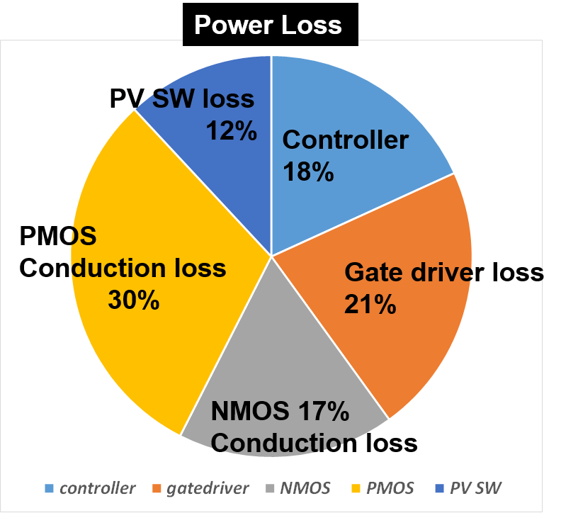
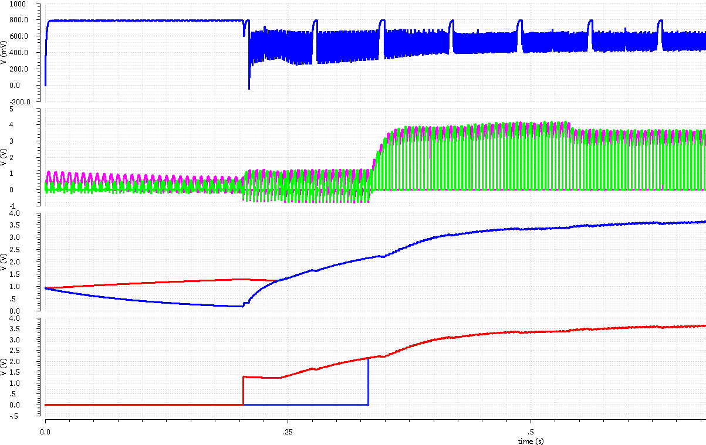
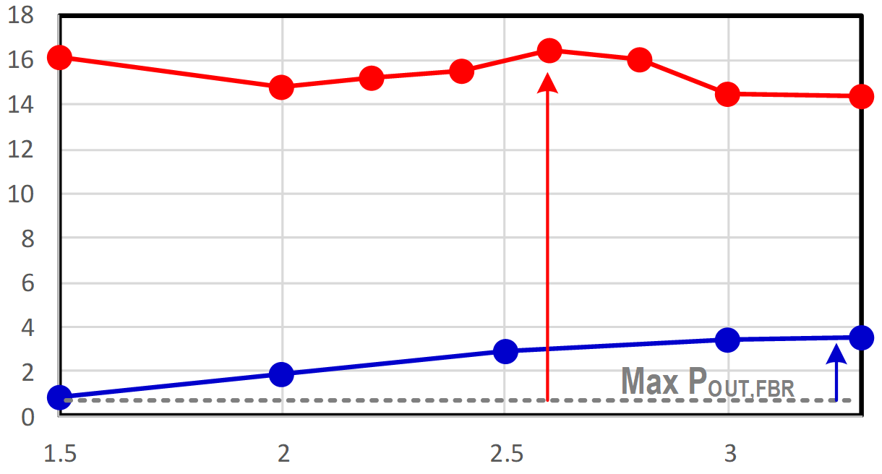
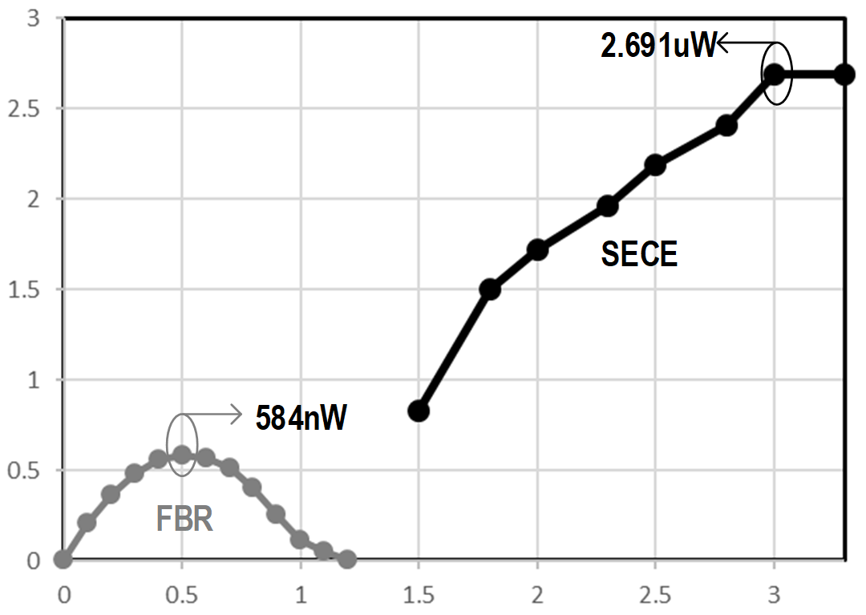
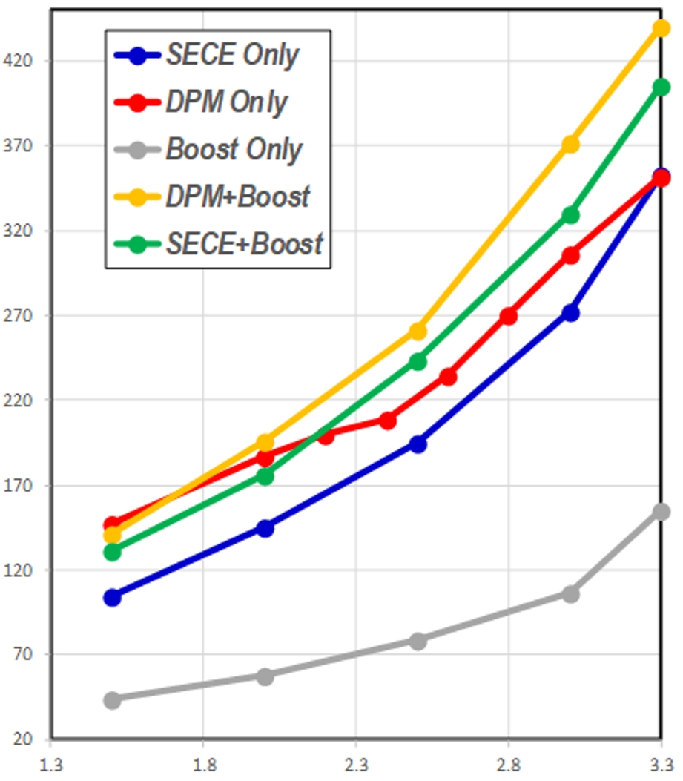
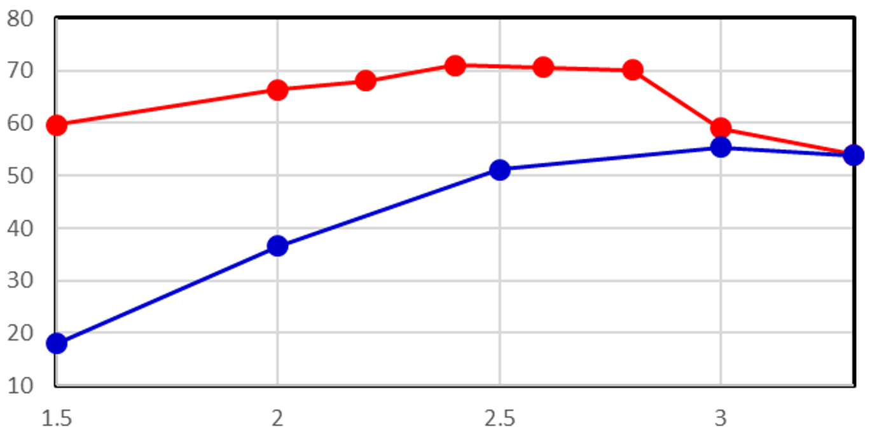
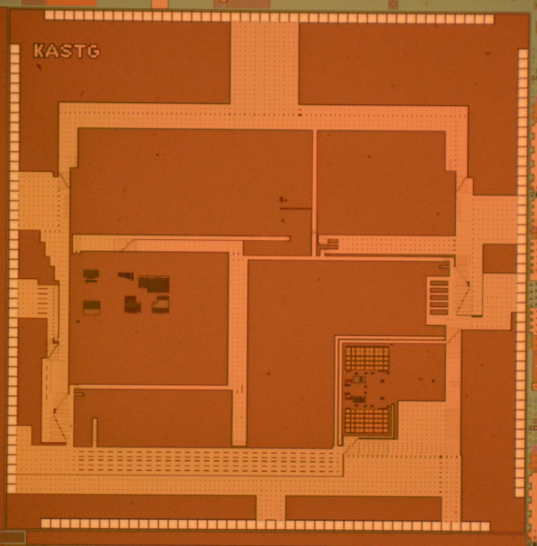
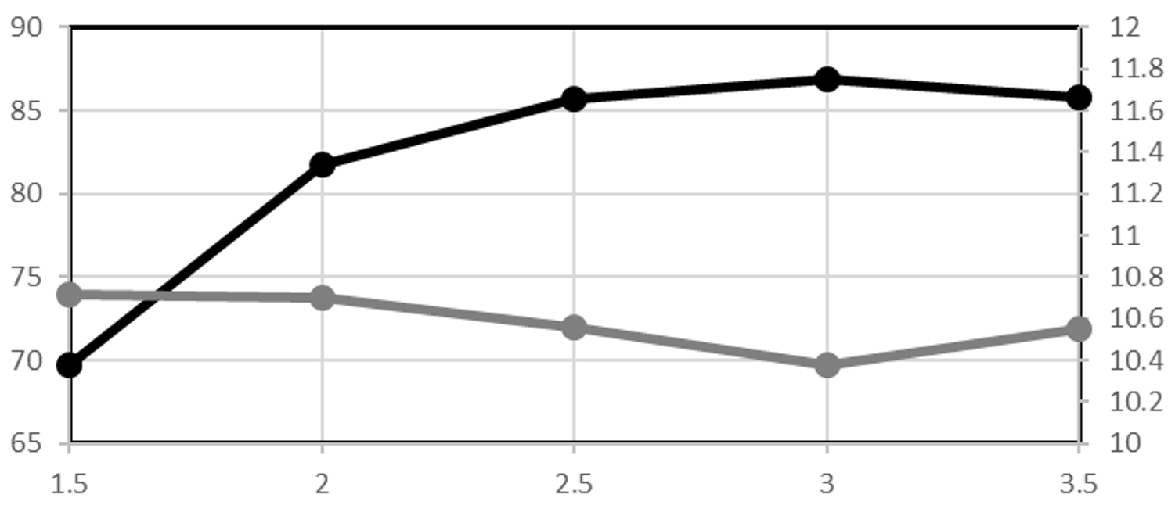
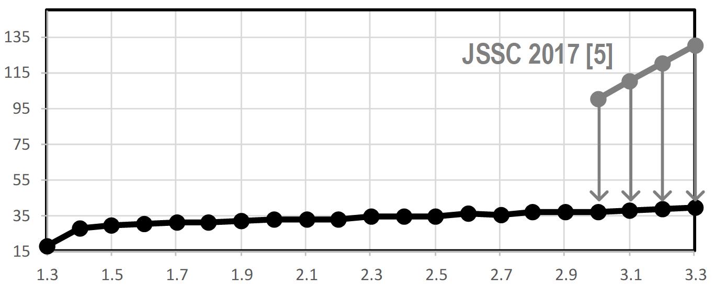
Heterogeneous Multi-Source Energy Harvesting Interface IC
Tae-Gyun Song^{1,2}, Chan-Hyu Jeon¹, Se-Un Shin², and Hyun-Sik Kim¹
¹School of Electrical Engineering, KAIST, ²Dept. of Electronics & Electrical Engineering, Dankook University
Abstract
Proposed Dual-Energy Harvesting I/F Chip Architecture
This study presents a novel Piezoelectric + Photovoltaic(PV) simultaneous dual-energy harvesting interface topology with ultra-low power control circuit. The circuit works in synchronous electric charge extraction(SECE) mode for shock vibrations, and double pile-up(DPM) for successive vibrations to achieve high Piezo energy extraction FoM. To extract PV energy efficiently, MPPT control is adopted. The proposed topology supports a true cold startup which realizes self-powered energy harvesting system. Simulated results showed power extraction FoM of 1,645% and power conversion efficiency(PCE) of 86.9%. The prototype chip was fabricated in 0.18-µm CMOS with 5mm x 5mm active area.
Proposed Multi-Source Energy-Harvesting Interface Topology
Various Working Modes: depending on the energy source pattern(Piezo or PV or Both) & amount of charged energy
SECE & Energy double pile-up(DPM) are used for Piezoelectric harvesting, and MPPT control optimizes Photovoltaic harvesting
Passive Energy Harvesting for Cold Startup(Low Energy)
V_{PV} > V_{STORE}
V_{PV} < V_{STORE}
Passive full-bridge rectifier (FBR)
S_{ST} works as a diode
For startup:
V_{PL} > 1.2V + 0.5V(V_{D})
PV energy is directly transferred to C_{STORE} by passive diode
Asynchronous constant on-time (CoT) boost converter using inductor (L_{IND})
Dual-energy harvesting can be available for cold startup
Mode # | Vibration (Piezo) | Solar (PV) | Charged Energy
1 | Inputted | No | Low (V_{STORE} < 1.2V)
Mode # | Vibration (Piezo) | Solar (PV) | Charged Energy
2 | No | Inputted | Low (V_{STORE} < 1.2V)
Mode # | Vibration (Piezo) | Solar (PV) | Charged Energy
2 | No | Inputted | Low (V_{STORE} < 1.2V)
Mode # | Vibration (Piezo) | Solar (PV) | Charged Energy
1 + 2 | Inputted | Inputted | Low (V_{STORE} < 1.2V)
C_{OUT}-C_{STORE} connection after startup
(V_{STORE} > 1.2V)
Active Energy Harvesting after Startup
Maximized Energy Harvesting
SECE is optimized for shock (non periodic) vibration
SECE: synchronous electric charge extraction
Behaving like a boost converter
Energy pile-up maximizes energy extraction from piezo under successive vibrations
Synchronous constant on-time (CoT) boost converting operation with MPPT control
PV and Piezo energies can be harvested, simultaneously by time-interleaving for inductor sharing
Mode # | Vibration (Piezo) | Solar (PV) | Charged Energy
3 | Shock Vibration | No | V_{STORE} > 1.2V
Mode # | Vibration (Piezo) | Solar (PV) | Charged Energy
4 | Successive Vibration | No | V_{STORE} > 1.2V
Mode # | Vibration (Piezo) | Solar (PV) | Charged Energy
5 | No | Inputted | V_{STORE} > 1.2V
Mode # | Vibration (Piezo) | Solar (PV) | Charged Energy
3 + 5 | Shock Vibration | Inputted | V_{STORE} > 1.2V
4 + 5 | Successive Vibration | Inputted
Simulated Results
Prototype chip fabricated in 180-nm CMOS process/ 5mm x 5mm active area
Piezo Energy Harvesting: Max. FoM = 1,645% in DPM with successive vibration, Max. FoM = 460% with shock vibration
PV Energy Harvesting: Peak power conversion efficiency(PCE) = 86.9% @ V_{OUT} = 3V
Quiescent Current [nA]
during Harvesting
Key Operational Waveforms
Piezoelectric Harvested Output Power [μW]
Piezo-Harvested Output Power [μW] for Shock Vibration
V_{OUT}
PV Voltage (V_{PV})
Open-circuit voltage sampling for MPPT
x16
Higher
V_{PZ,OC} = 0.6V
F_{PZ} = 140 Hz
3
2.5
2
1.5
1
0.5
0
Async. Boost Converting
Synchronous CoT Boost Converting w/ MPPT
DPM (16μW)
Piezo Voltage (V_{PL} & V_{PR})
SECE Harvesting
FBR (1μW)
SECE (~4μW)
FBR
SECE
Passive FBR for Startup
Energy Pile-Up Harvesting
x4
V_{OUT}
V_{PZ,OC} = 1.6V
Shock (0.2s) per 1 sec
Fabricated Prototype Chip
0 0.5 1 1.5 2 2.5 3
(Temporal Storage) V_{STORE}
(Main Storage) V_{OUT}
Pile-Up technique virtually increases Piezo voltage and maximizes FoM
Piezoelectric PCE [%] for Successive Vibration
V_{OUT}
Charged Energy-Level on Super-Cap
PV (Solar) Harvested Output Power [μW] & PCE [%]
V_{OUT}
(Startup) S_{ST}
Energy Pile-Up Mode
DPM
PCE [%]
Power [μW]
Quiescent Current [nA]
at idle state
Different operations for each working mode are automatically controlled by the internal sensors and pattern recognition block on the chip
SECE
This work
State-of-the-art
PV+Piezo dual-energies are being harvested from the point of cold-start (zero-energy on cap)
V_{PZ,OC} = 0.6V
F_{PZ} = 140 Hz
V_{PV,OC} = 0.7V
Conclusion
V_{OUT}
V_{OUT}
V_{OUT}
Magnachip/SK-Hynix 180nm CMOS (5mm x 5mm)
The proposed dual-energy harvesting I/F IC achieved power extraction FoM of 1,645% and power conversion efficiency of 86.9%. With ultra low power control blocks, the circuit operates on different modes depending on the extractable energy source and supports true cold-startup without previously-charged-energy or battery.
Acknowledgement
The chip fabrication and EDA tool were supported by the IC Design Education Center (IDEC), Korea.

